Slide 1
DIABETIC RETINOPATHY SEVERITY DETECTION
Name :
Roll No:
Panel:
Department : (Computer Engineering and Technology)
Programme : TYBTech
Guide Name : Dr. Pradnya Kulkarni

Slide 2
OUTLINE
Introduction
Background and Motivation
Literature Review
Research Gap
Base Paper Explanation
Conclusion and future scope
References

Slide 3
INTRODUCTION - MOTIVATION
India is set to emerge as the diabetic capital of the world.
The diabetic population in the country is close to hitting the alarming mark of 69.9 million by 2025 and 80 million by 2030.
The overall population affected by this diabetes-related retinal disease is reported to be 382 million as per the statistics of 2013, and it is expected to cross the number of 592 million by 2025.
India has about 3500 trained retina specialists against 60 million diabetic patients facing diabetic eye disease.
Diabetic retinopathy is one such complication that is affecting nearly 18% of the diabetic population in India.

Slide 4
BACKGROUND
Diabetic Retinopathy damages blood vessels in the retina which then begin to leak fluids and blood
When this fluid leaks it can cause the macula to swell or thicken. This is called diabetic macular edema (DME)
Stages of diabetic retinopathy :
Non Proliferative Diabetic Retinopathy :
Mild non proliferative retinopathy
Moderate non proliferative retinopathy
Severe non proliferative retinopathy
Proliferative Diabetic Retinopathy

Slide 5
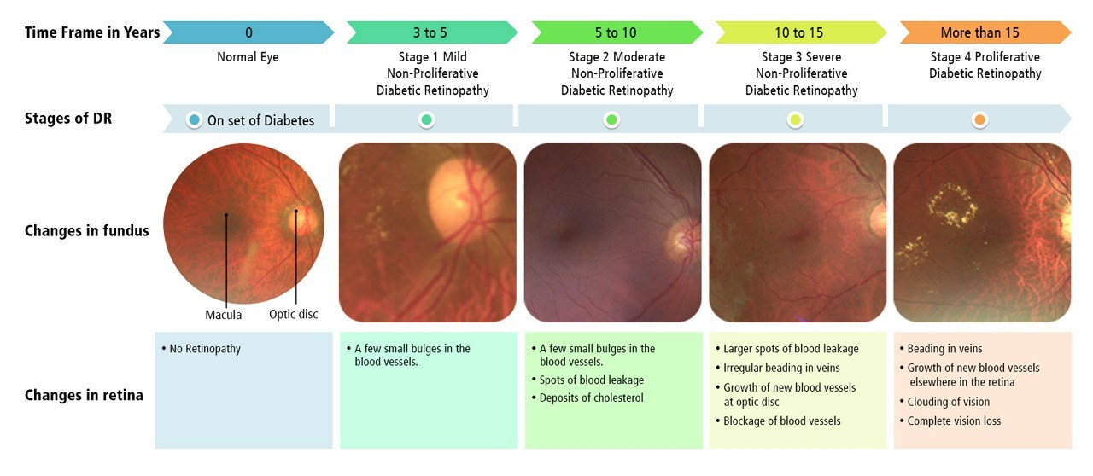
STAGES OF DIABETIC RETINOPATHY

Slide 6
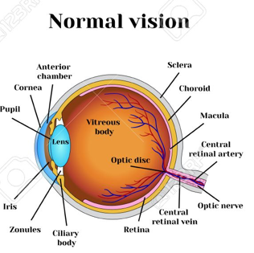
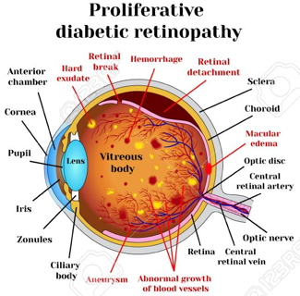
Vs

Slide 7
LITERATURE REVIEW
LITERATURE REVIEW
Sr No | Title of the paper | Author | Year of publication | Dataset used | Methods used | Accuracy | Research Gap
1. | Convolutional Neural Networks for Diabetic Retinopathy | Harry Pratta, Frans Coenen, Deborah M Broadbent, Simon P Harding, Yalin Zheng | 2016 (Elsevier) | Kaggle dataset (80,000 images) | CNN | 75% | It cannot accurately distinguish the mild, moderate and severe cases of DR.
2. | Diabetic Retinopathy Classification using Deeply Supervised ResNet | Debiao Zhang,Wei Bu, Xiangqian Wu | 2017 (IEEE) | Kaggle dataset( >35,000 images) | Deeply supervised ResNet | 80% | Around half of the mild and moderate images are misclassified into normal, which is a severe problem in real life.

Slide 8
LITERATURE REVIEW
Sr No | Title of the paper | Author | Year of publication | Dataset used | Methods used | Accuracy | Research Gap
3. | Classification of Diabetic Retinopathy Through Texture Features Analysis | Bariqi Abdillah , Alhadi Bustamam, Dewi Sarwinda | 2017(IEEE) | DiaretDBO (130 images) | Local Binary Pattern, SVM, k-NN | 90% | The accuracy is not as high as binary classification because of unbalance data and miss categorization of lesion characteristics.
4. | Classification of Diabetic Retinopathy Stages using Histogram of Oriented Gradients and Shallow Learning | Devvi Sarwinda, Titin Siswantining, Alhadi Bustamam | 2018(IEEE) | DIARETDB0,DIARETDB (111 images) | Histogram of Oriented Gradients, Random Forest, SVM | 85% | Mild NPDR vs. Normal has lower accuracy than other classification. The dataset consists of less no of images.

Slide 9
LITERATURE REVIEW
Sr No | Title of the paper | Author | Year of publication | Datasets used | Methods used | Accuracy | Research Gap
5. | Automatic Lesions Detection and Classification of Diabetic Retinopathy Using Fuzzy Logic | Rubya Afrin,Pintu Chandra Shill | 2019 (IEEE) | STARE, DIARETDB0DIARETDB1 (400 images) | Fuzzy classifier | 95.63% | The classifier performance can be improved with more images and extracting more features.

Slide 10
RESEARCH GAP
cannot accurately distinguish the mild, moderate and severe cases of DR
Around half of the mild and moderate images are misclassified into normal, which is a severe problem in real life.
The accuracy is not as high as binary classification because of unbalance data and miss categorization of lesion characteristics.
Mild NPDR vs. Normal has lower accuracy than other classification. The dataset consists of less no of images.
The classifier performance can be improved with more images and extracting more features.

Slide 11
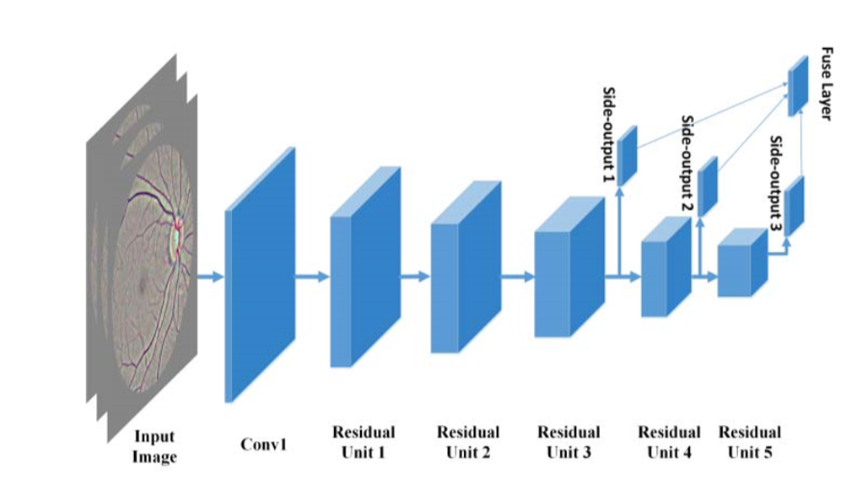
BASE PAPER DETAILS
Paper Name : Diabetic Retinopathy Classiﬁcation using Deeply Supervised ResNet.
Published in : 2017 IEEE Smart World, Ubiquitous Intelligence Computing, Advanced Trusted Computed, Scalable Computing Communications, Cloud Big Data Computing, Internet of People and Smart City Innovation Conference.
Dataset : Kaggle dataset which contains more than 35,000 images.
Network Architecture :

Slide 12
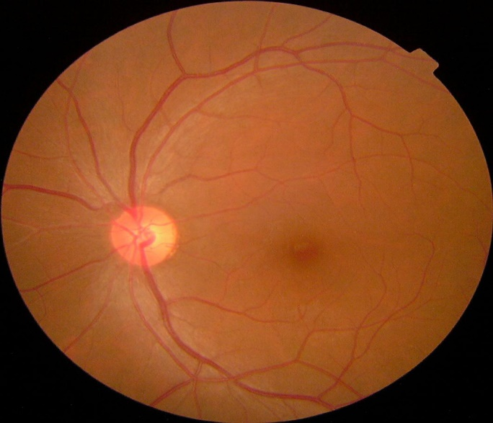
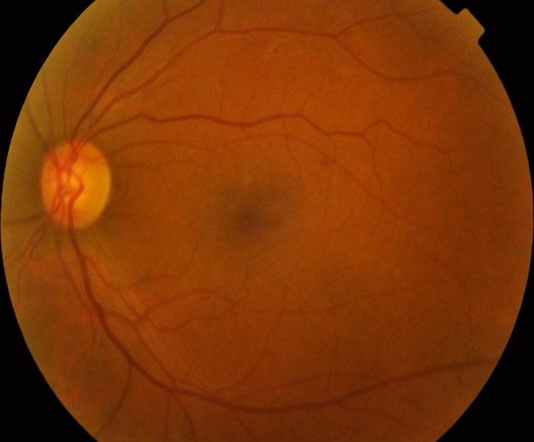
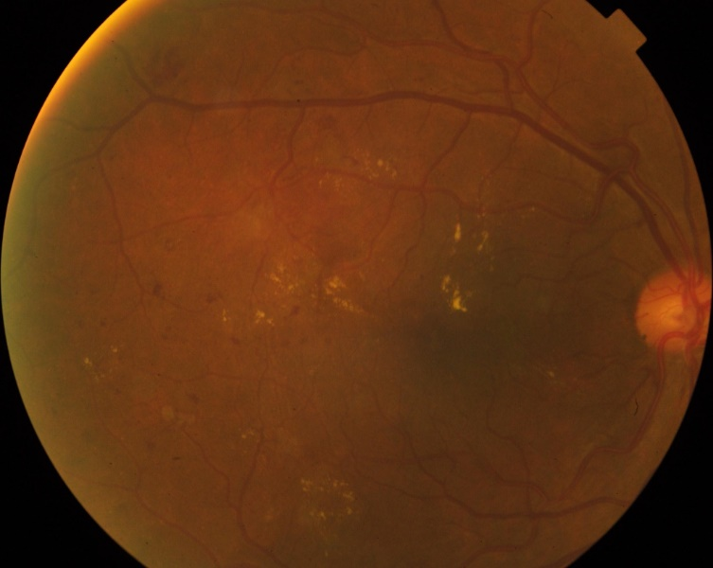
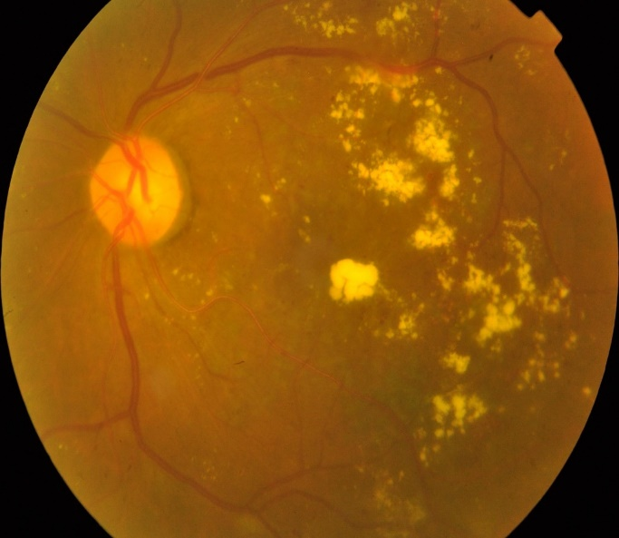
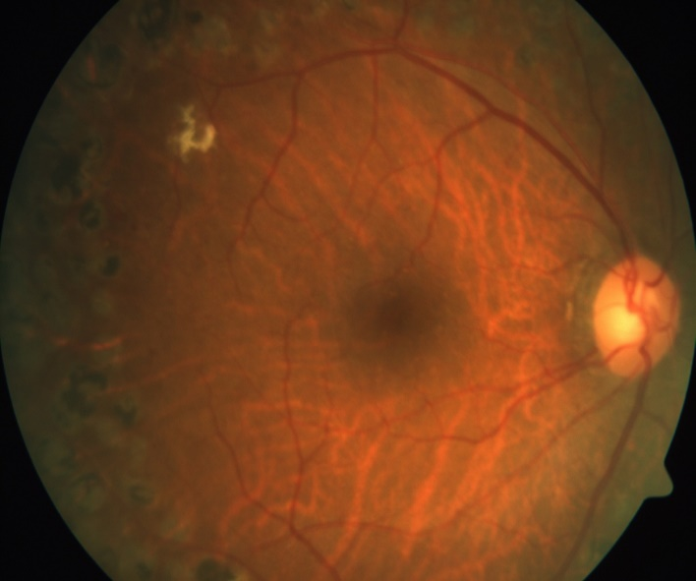
BASE PAPER DETAILS : DATASET SAMPLES
0 – No DR
1 – Mild NPDR
2 – Moderate NPDR
3 – Severe NPDR
4 – PDR

Slide 13
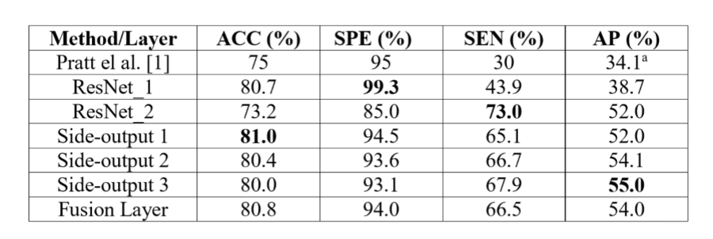
BASE PAPER DETAILS
5. Implementation Steps :
Pre-processing
Data Augmentation
Network Parameters
Training and Testing
Results

Slide 14
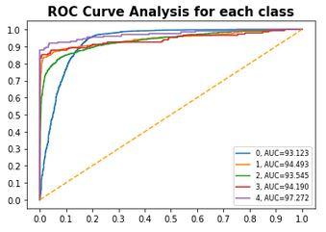
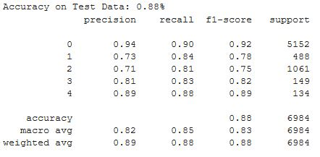
Base Paper Results
Classification Result : ROC :
TPR
FPR

Slide 15
CONCLUSION AND FUTURE SCOPE
The reason of miss classiﬁcation is that the mild and moderate DR are mainly decided by the subtle parts such as micro aneurysms whose feature may be lost as feed forwarding through the network.
Considering that color fundus images are usually of high resolution and the fact that different classes of DR are highly related to different lesions, a method by combining the predictions of image level and discriminative patch level CNNs may further improve the classiﬁcation performance.
Real time dataset can enhance and prove the accuracy and effectiveness of the retinopathy detection technique which is possible with the help of Australian researchers.
Diabetic Macular Edema is a future extension to the work done in the base paper.
Further for improving accuracy, various models of CNN will be explored.

Slide 16
SELECTED REFERENCES
Harry Pratta, Frans Coenen, Deborah M Broadbent, Simon P Harding, Yalin Zheng , “ Convolutional Neural Networks for Diabetic Retinopathy ”, 2016, Elsevier B.V.
May Phu Paing, Somsak Choomchuay, Rapeeporn Yodprom, “ Detection of Lesions and Classiﬁcation of Diabetic Retinopathy Using Fundus Images ” , 2016 IEEE.
Bariqi Abdillah, Alhadi Bustamam, Dewi Sarwinda, “ClassiﬁcationofDiabetic Retinopathy Through Texture Features Analysis ”, 2017 IEEE.
Debiao Zhang, Wei Bu, Xiangqian Wu, “ Diabetic Retinopathy Classiﬁcation using Deeply Supervised ResNet ”, 2017, IEEE.
S.T. Lim, M.K. Ahmed , S.L. Lim, “ Automatic Classiﬁcation of Diabetic Macular Edema using a Modiﬁed Completed Local Binary Pattern (CLBP) ” , 2017 IEEE.
Sarfaraz Masood, Tarun Luthra, Himanshu Sundriyal, Mumtaz Ahmed,“ Identiﬁcation of Diabetic Retinopathy in Eye Images Using Transfer Learning ” , 2017 IEEE.
Z. A. Omar, M. Hanaﬁ, S. Mashohor, N. F. M. Mahfudz , M.Munaim , “ Automatic Diabetic Retinopathy Detection and Classiﬁcation System”, 2017 IEEE.

Slide 17
ANY QUESTIONS???

Slide 18
THANK YOU

